Slide 1
How to get a library eBook on a Nexus 7
Step-by-Step Guide
Prepared by the Computer Lab
Montgomery County-Norristown Public Library
October 2014

Slide 2
The following screenshots were made using a Nexus 7 running the KitKat version of the OS. Your tablet may differ. This is meant as a general guide. If you are unfamiliar with your Nexus 7, please see the tutorial on Setting Up and Using a Nexus 7. Be aware that the latest version of OverDrive requires at least Android 4.0 installed on your Nexus. To make sure you have the latest updates to your device, go to Settings > System > About tablet > System updates.

Slide 3
Overview of Basic Steps
Download the OverDrive App to your tablet.
Sign up for an OverDrive account.
Use the OverDrive app to search library digital collection and check out a book.
Use OverDrive to read and manage your eBooks.

Slide 4
What do I need to get started?
You will need:
A library card based on a residency in Montgomery County
Access to the internet either through your providers data network, or through a Wi-Fi access point
A valid email address to sign up for an OverDrive account
Your Nexus 7 with Google Play Store installed

Slide 5
Policies and tips to bear in mind when borrowing eBooks…
Valid Montgomery County library card
Borrowing period- 7, 14 or 21 days
Borrowing limits-10 items at one time (audio and eBooks combined)
Renewable –There is a renew feature which allows you to place advance holds on titles that you currently have checked out. This feature is available three days prior to expiration of your title. You need to do this proactively. You will not be prompted.
Reserving – limited to 10 items at one time (audio and eBooks combined)
Pick up a reserve book within 72 hours of email notification
Late Fees – None!
“Shopping” cart – lasts only 30 minutes!

Slide 6
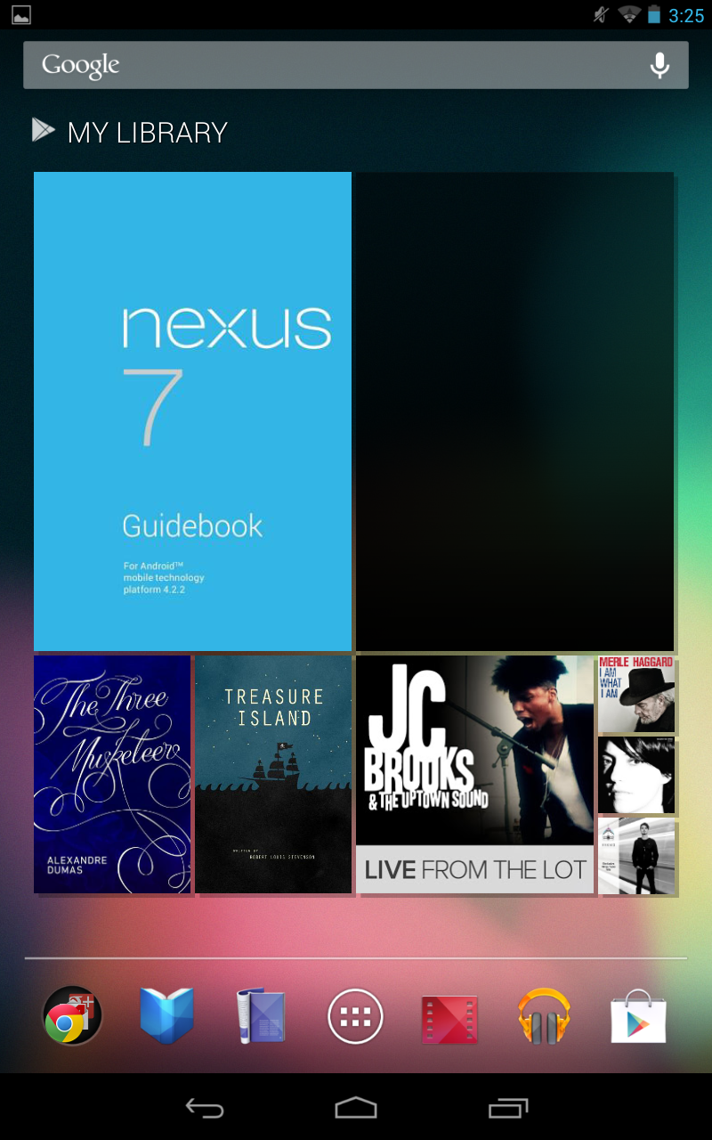
Getting the OverDrive App
Tap on the Play Store app icon (far right on your favorites tray, looks like a shopping bag with a triangle)

Slide 7
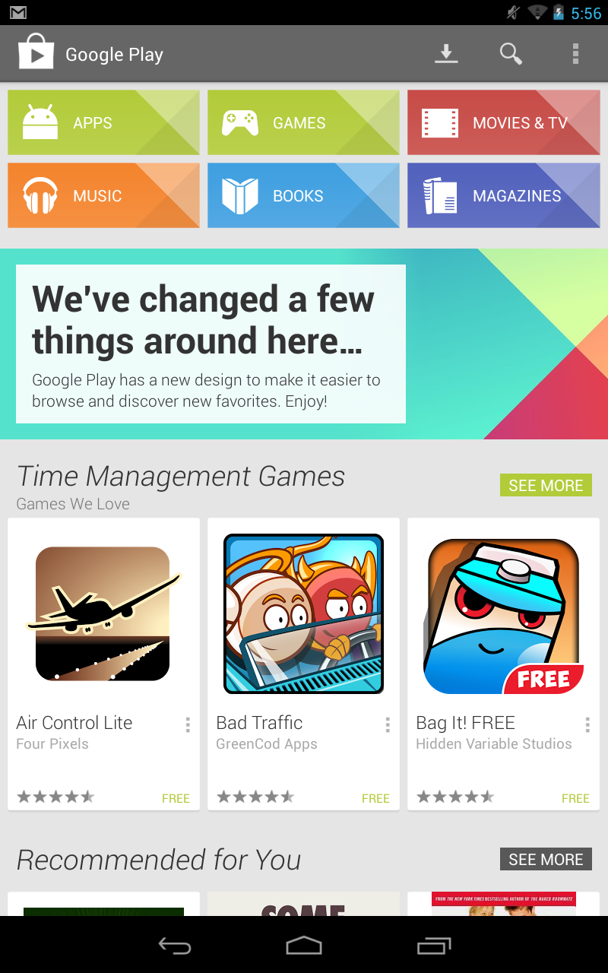
Getting the OverDrive App
This is the Google play store. You can use this to download apps, games, music, etc. There are plenty of things to download that are free and do not even require that you enter a credit card. The OverDrive app that we will be downloading is one of those free apps. To find it, tap on the magnifying glass in the upper right.

Slide 8
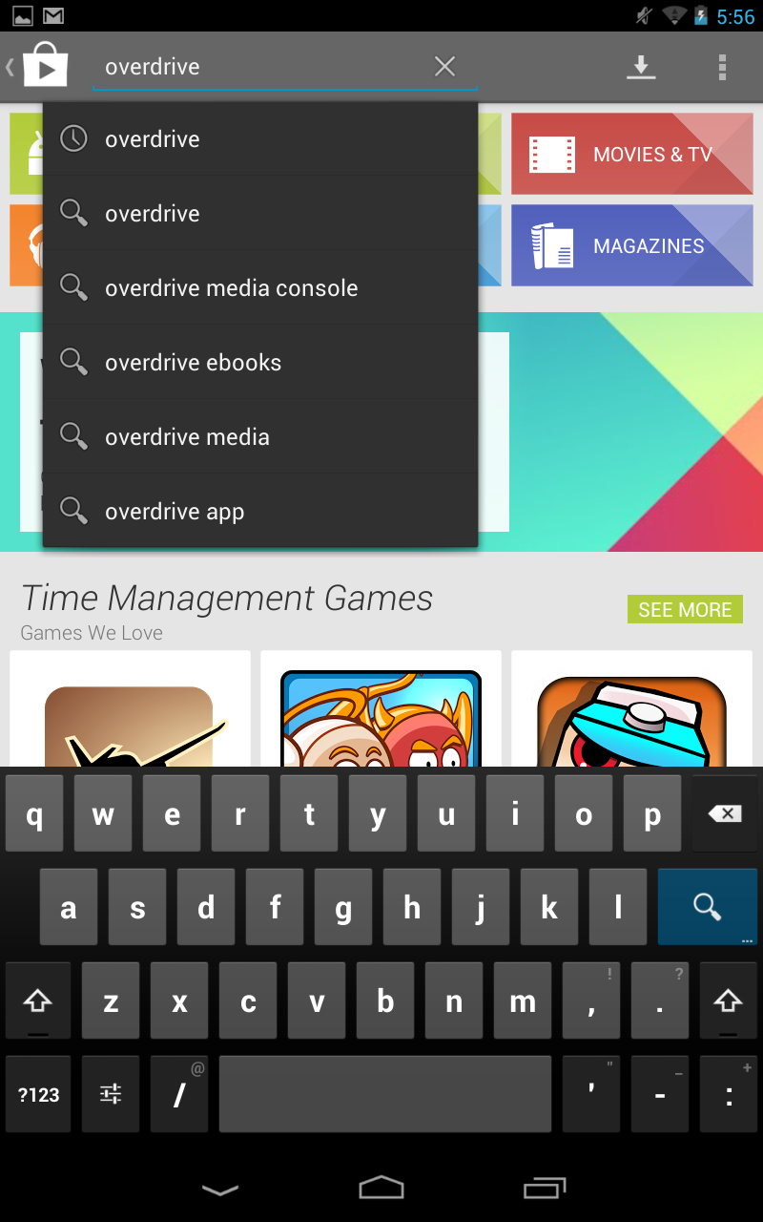
Getting the OverDrive App
Type in “OverDrive” in the search field.
You may notice the “OverDrive” appears on the list that drops down. This is a suggested search listing, but we are just going to tap the magnifying glass on the keyboard.

Slide 9
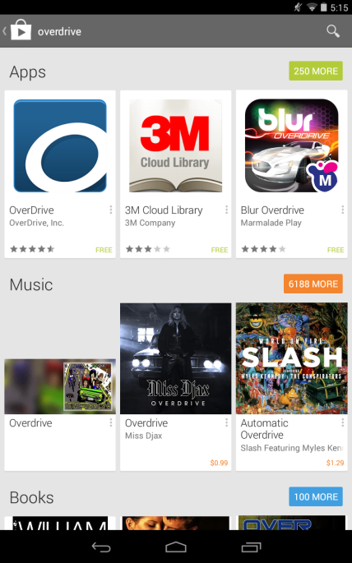
Getting the OverDrive App
This is a list of your search results. The OverDrive app should be listed at the top. Make sure it is made by “OverDrive Inc”. You will notice it also says “Free” meaning you do not need your credit card to purchase this app, nor will you be asked to enter one for your account. Tap anywhere on the picture.

Slide 10
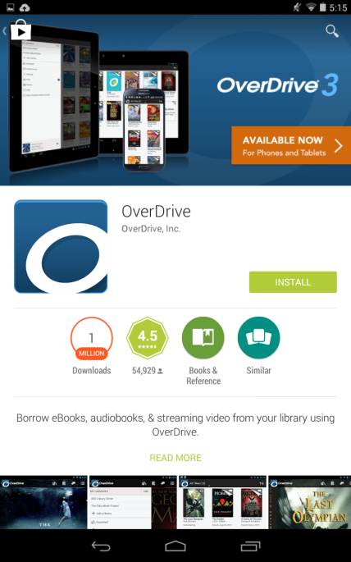
Getting the OverDrive App
This the page of the app that describes what it does, along with some screenshots and reviews. Tap on the “Install” button.

Slide 11
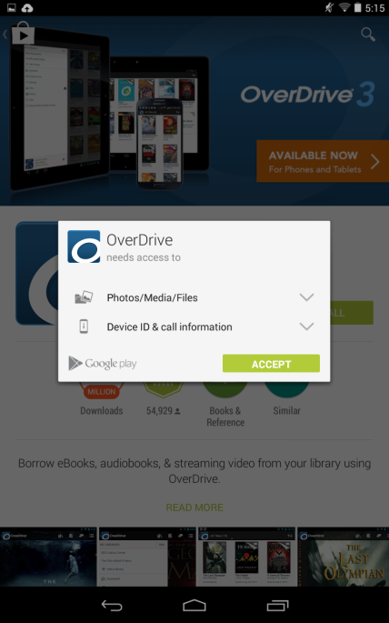
Getting the OverDrive App
The app asks for some standard access permissions so you can enjoy eBooks and audiobooks on your device.
Tap on the “Accept” button.

Slide 12
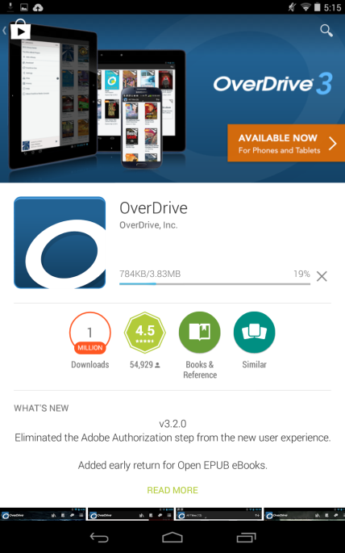
Getting the OverDrive App
The app is now downloading and you can see a status of the download.

Slide 13
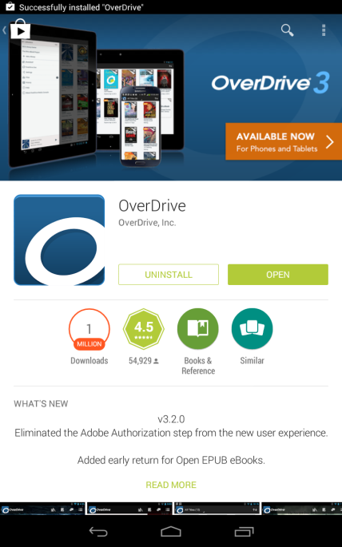
Getting the OverDrive App
When it finishes downloading, you will see two new buttons, “UNINSTALL” and “OPEN”. Tap OPEN to open the app.

Slide 14
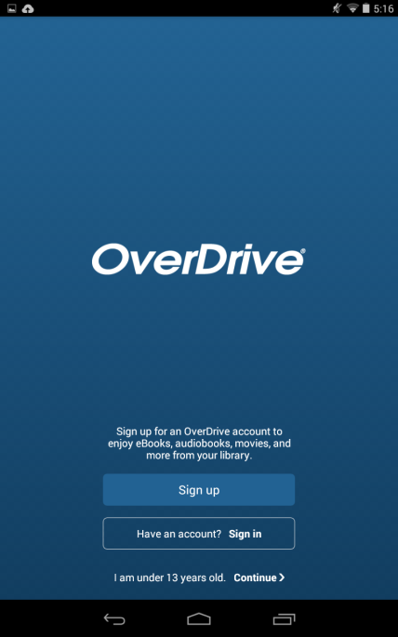
Getting the OverDrive App
If this is the first time you are downloading the app, you will be required to sign up for an OverDrive account, or login with a current one.
Click the “Sign up” button if this is the first time using this app.

Slide 15
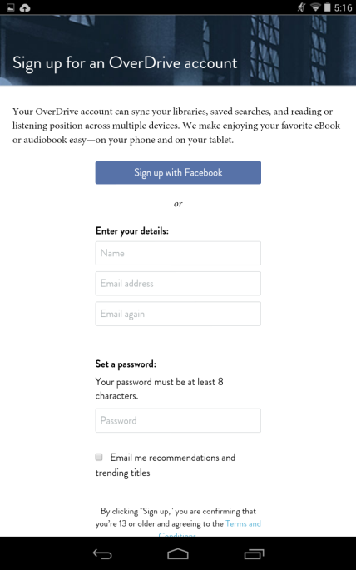
Getting the OverDrive App
If you have a Facebook account, you can easily use that to sign up with OverDrive. It will automatically link with Facebook so you can use your same login credentials. Otherwise you can sign up by entering your email address and a password.
As of this writing, there is only one password field, so make sure you take your time and enter your password correctly. After you are done, scroll down and tap the “Sign up” button.

Slide 16
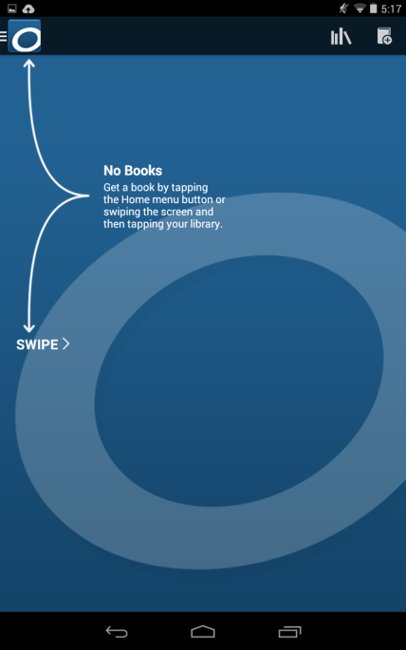
Getting the OverDrive App
Once you create an account, you will automatically be signed in to the app and brought to the main screen. You will not be required to sign in again, unless you need to login on another device
This main screen is empty, but when you finally add some books in your bookshelf, the last book you read will show here instead.
Tap on the Menu button or swipe the screen as instructed.

Slide 17
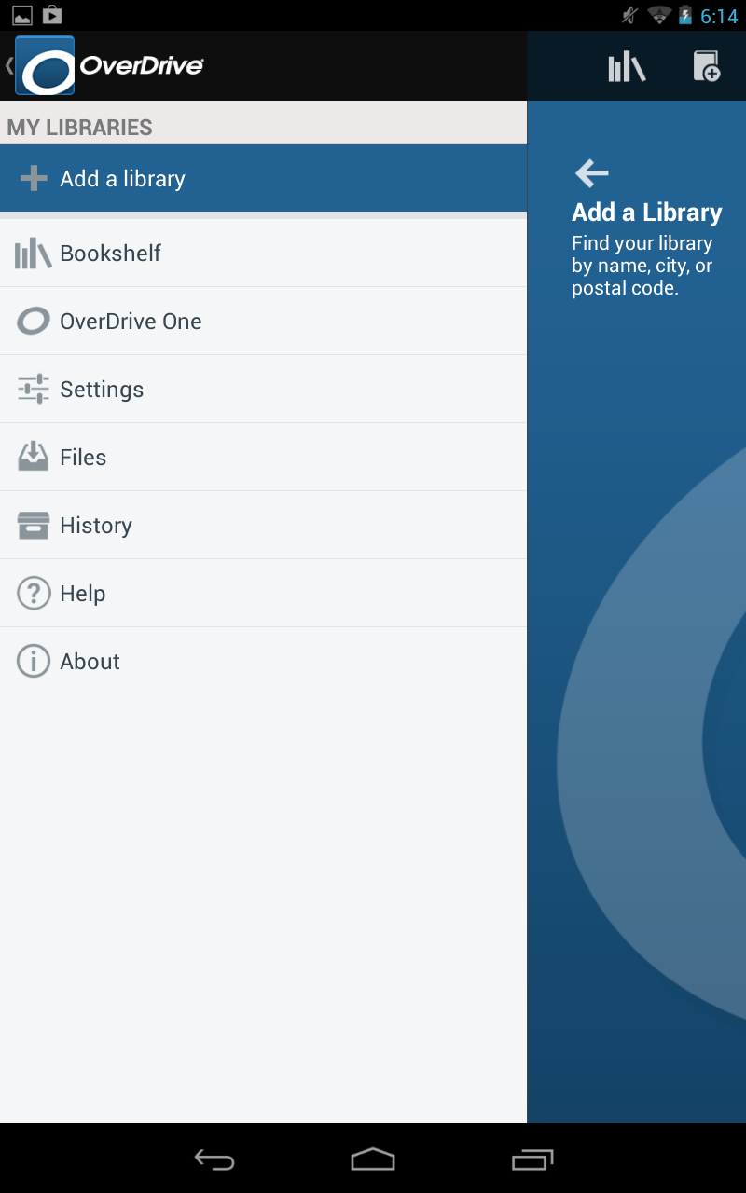
Using the OverDrive App
Getting started with the
OverDrive App
You will need to tell OverDrive which library you belong to.
Tap on the “Add a Library” button

Slide 18
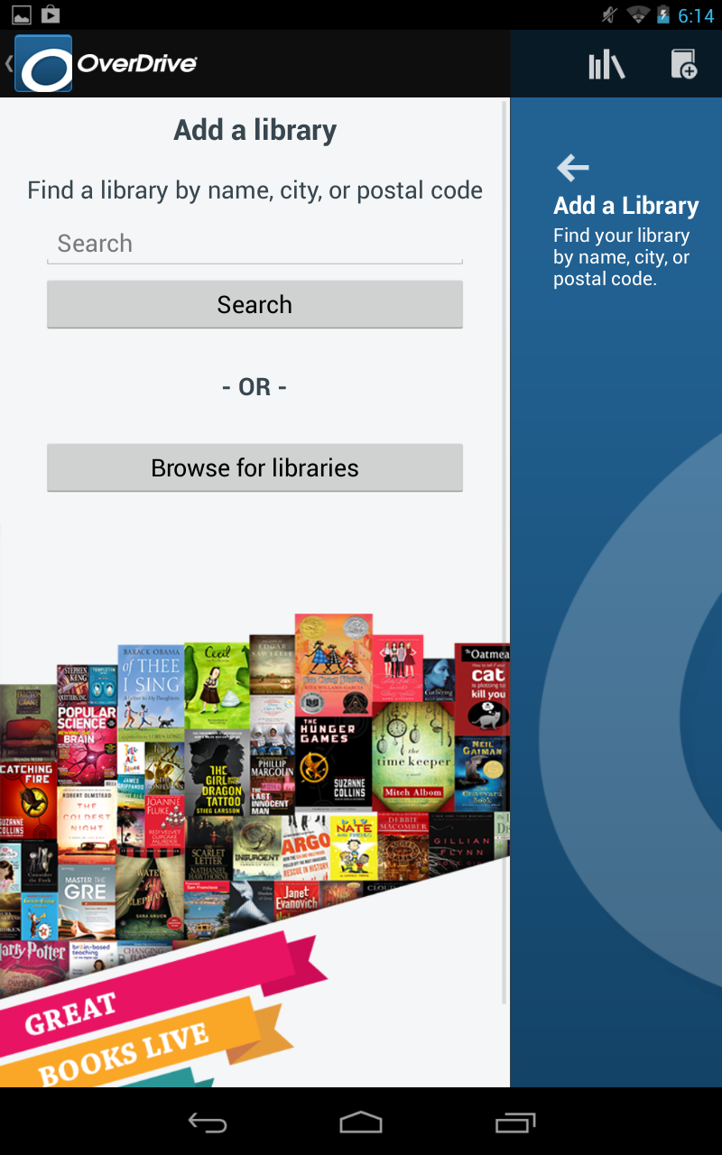
Using the OverDrive App
Getting started with the
OverDrive App
In the search field, type the name of the town where your library is and tap the “Search” button.
We are going to search for the library in Norristown.

Slide 19
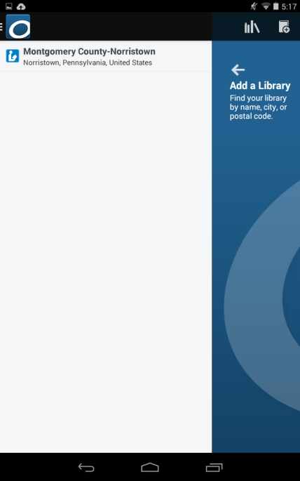
Using the OverDrive App
Getting started with the
OverDrive App
A list of libraries in and near your town may display.
Scroll or swipe until you see your library. Then tap on it.
Ours was the only one on the list because it’s the only library in Norristown

Slide 20
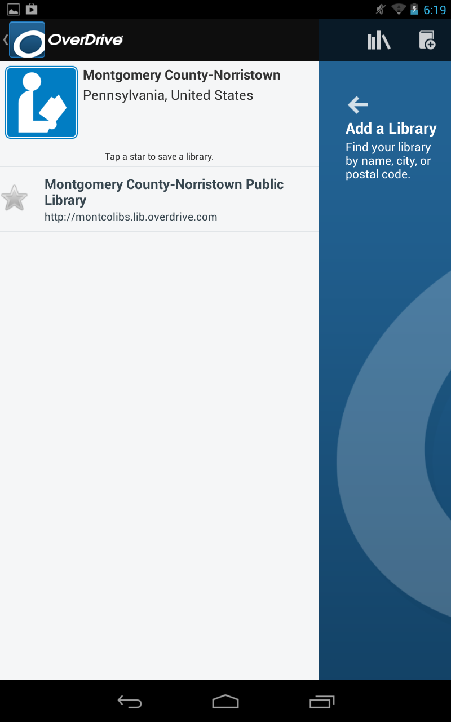
Using the OverDrive App
Getting started with the
OverDrive App
Tap on the star to add it to your library list. It will turn gold.
The library will remain in your libraries list. You won’t have to search for it again.

Slide 21
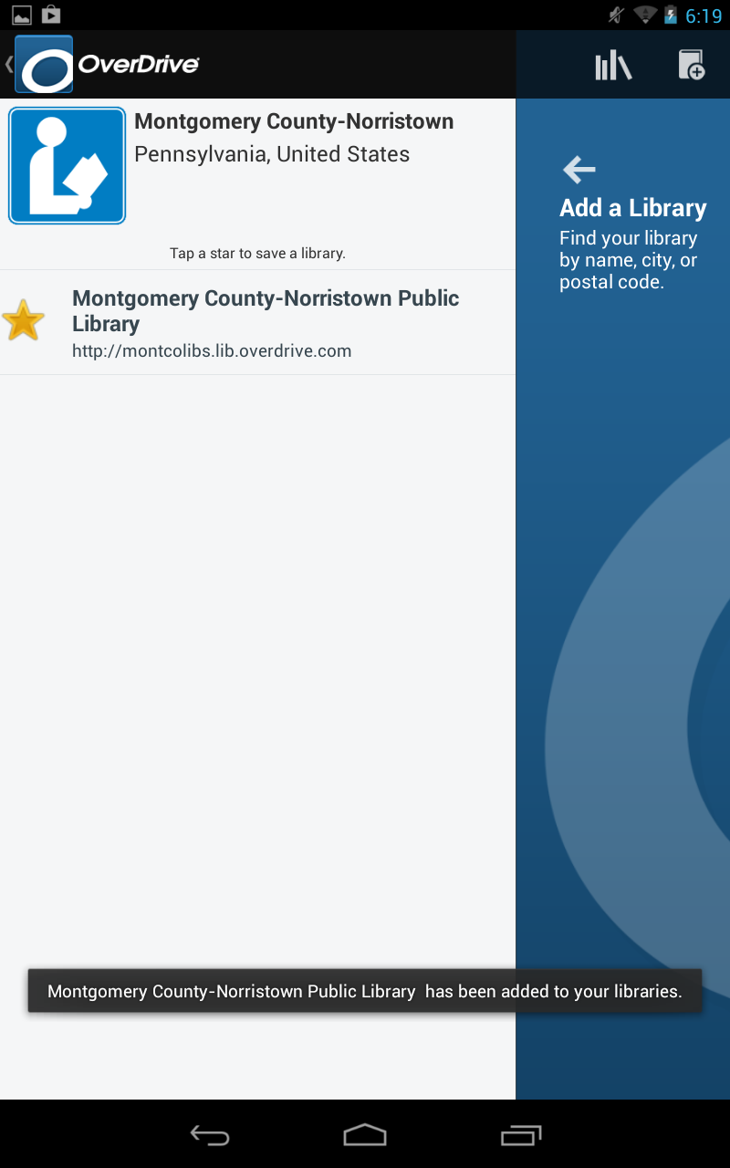
Using the OverDrive App
Getting started with the
OverDrive App
You will see confirmation that your library has been added to your Get Books list.
Then, tap the library name to be taken to the website that hosts the digital collection.
Confirmation

Slide 22
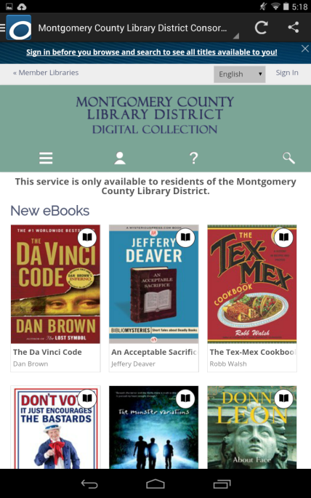
Using the OverDrive App
Getting started with the
OverDrive App
The website for the digital collection opens up in the OverDrive app.
Sign into the website before you start to search for eBooks.
Tap on the Sign In link.

Slide 23
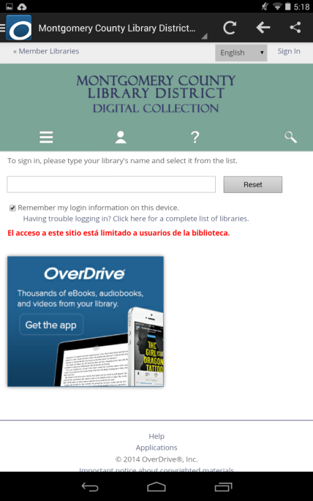
Using the OverDrive App
Getting started with the
OverDrive App
In the empty field, begin typing in the name of your library, which in our case is Montgomery.

Slide 24
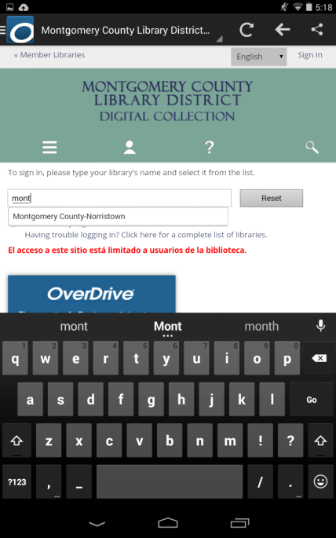
Using the OverDrive App
Getting started with the
OverDrive App
As soon as you begin typing, you should see a list of possible matches. Tap on your library name.

Slide 25
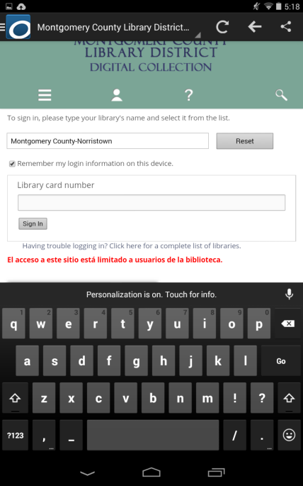
Using the OverDrive App
Getting started with the
OverDrive App
A new field will be displayed where you type in your library card number.
Then tap the Sign in button.

Slide 26
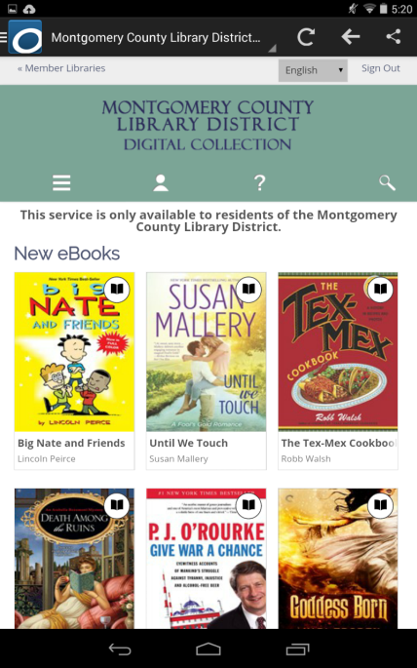
Using the OverDrive App
Getting started with the
OverDrive App
On the next screen, tap on the magnifying glass in order to start looking for a book.

Slide 27
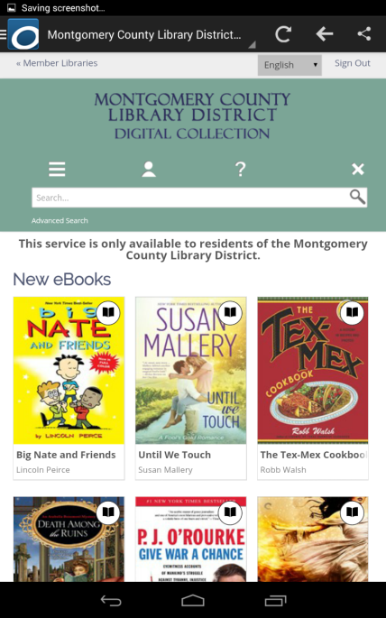
Using the OverDrive App
Getting started with the
OverDrive App
Our strategy right now is going to be to look for a book in the EPUB format (because that format is readable in our OverDrive app) and that is by a certain author.
In order to conduct a search using parameters we need to do an advanced search.
Tap on the Advanced Search link.

Slide 28
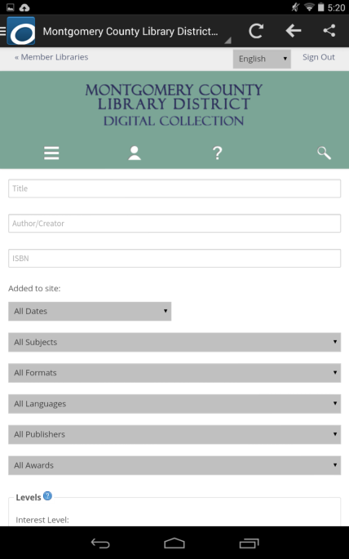
Finding and Borrowing a Library eBook
In the advanced search form, type Stephen King in the Author/Creator field.
Then tap the All Formats button.

Slide 29
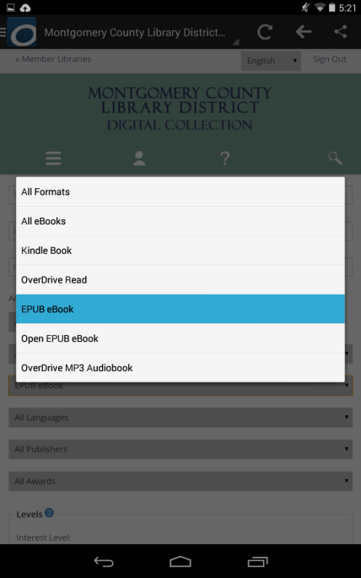
Finding and Borrowing a Library eBook
Most of the eBooks in the collection are in the EPUB format, and the OverDrive app is ideal for reading EPUBs.
Therefore, we’re going to limit our search to the EPUB format. Tap on EPUB eBook.

Slide 30
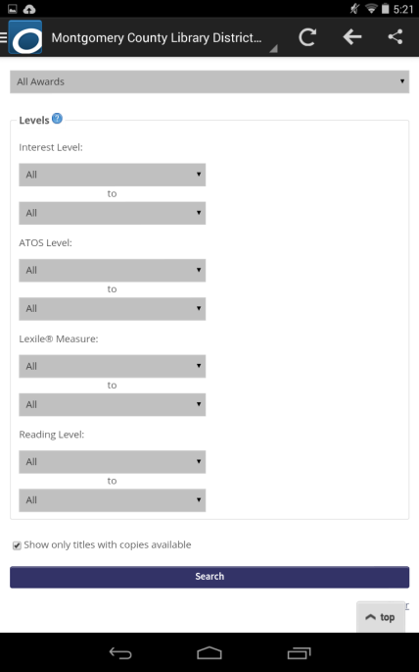
Finding and Borrowing a Library eBook
Next, tap into the checkbox next to Show only titles with copies available, and then tap Search.

Slide 31
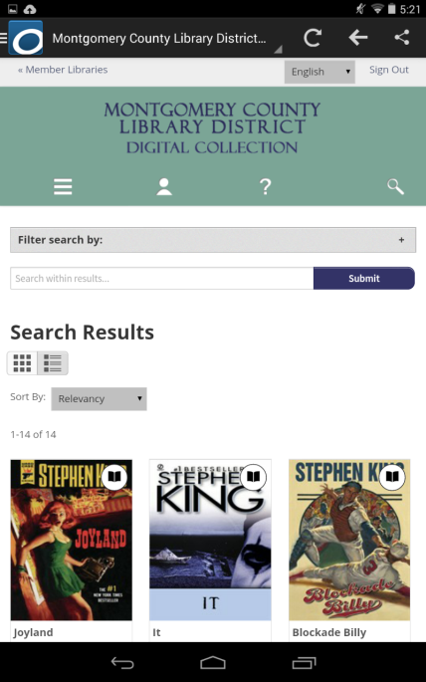
Finding and Borrowing a Library eBook
The Search results can be viewed in two different ways.
The Cover view shows only the Covers of books along with their title and author.

Slide 32
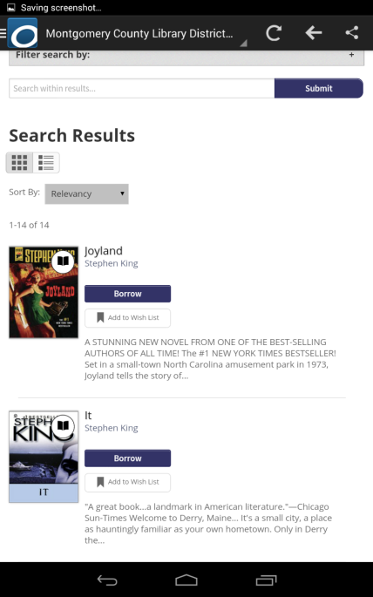
Finding and Borrowing a Library eBook
The List view gives you slightly different information and includes a Borrow button.
However, if you use the Borrow button, you won’t be able to choose a lending period. In order to choose a lending period you need to tap on the book cover.

Slide 33
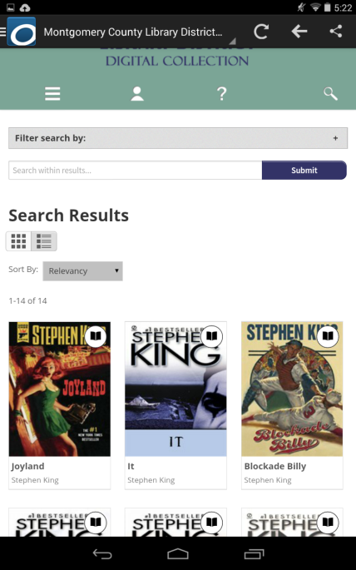
Finding and Borrowing a Library eBook
Back in the Cover view, we are scrolling through the results list and we decide to borrow Blockade Billy.
Tap on the cover of the book to open the borrowing options.

Slide 34
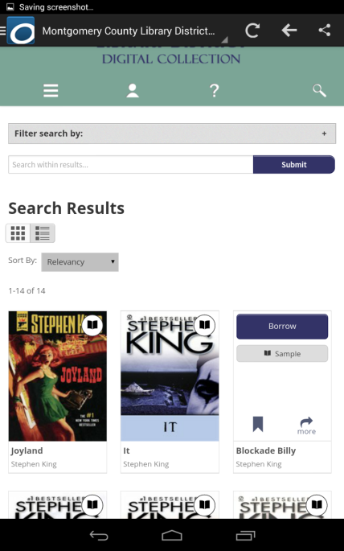
Finding and Borrowing a Library eBook
After you tap the cover, there are some quick options you can perform on the book. We want to see the page with all of the information pertaining to the book, so tap on the “more” button.

Slide 35
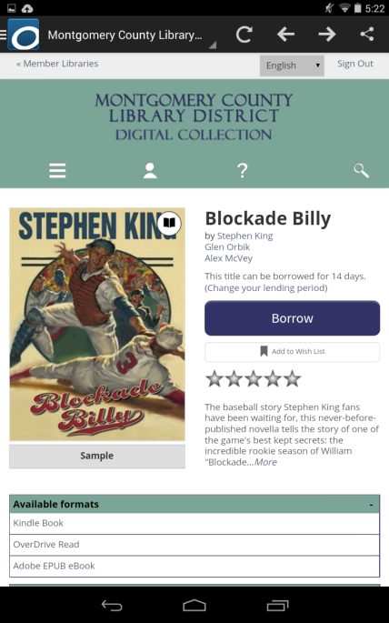
Finding and Borrowing a Library eBook
Note the Borrow button and the message underneath that says the title can be borrowed for 14 days.
This loan period draws from a setting in your account that applies to all digital loans.
The following screens show how to change this setting if you want the book for less or more time. We’ll start by tapping on “Change your lending period”.

Slide 36
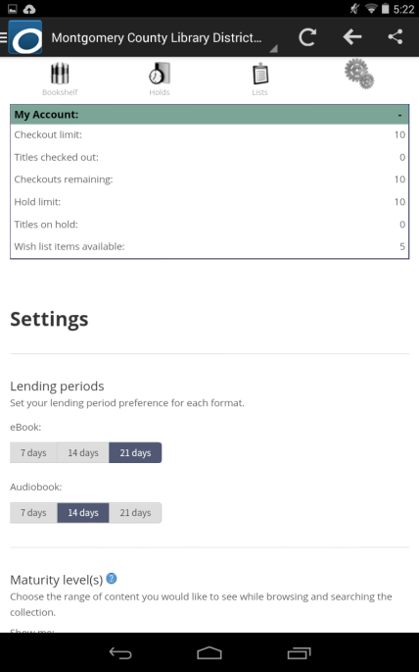
Finding and Borrowing a Library eBook
This screen is the account settings. Tap on the desired lending period for your eBooks. We’re going to change ours to 21 days.
Now tap the back button ONCE. Make sure to wait until the page loads. Tapping the back button twice exits the app, and you may have to start over again to get your book.

Slide 37
Finding and Borrowing a Library eBook
Back at the book, notice how the loan period has changed.
Be aware that the lending period will now be 21 days for every future book we borrow until we change the lending period again in our account settings.
Now tap the Borrow button.

Slide 38
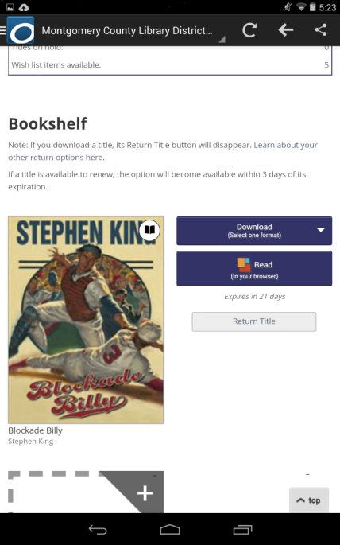
Finding and Borrowing a Library eBook
Once the book has been borrowed you will be brought to your OverDrive bookshelf where you will find the Download button.
Take note that in case you don’t want to keep this book after all, you have an opportunity to return the book directly from this page before you download it (see Return Title button). Once you download the book, you will only be able to return the book from within the app.

Slide 39
Finding and Borrowing a Library eBook
Notice that the Download button says that we need to pick a format. Tap the list arrow on the download button.

Slide 40
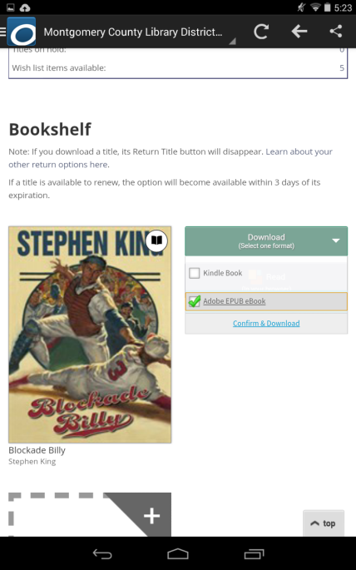
Finding and Borrowing a Library eBook
Make sure to select Adobe EPUB eBook. Once the format is selected from the drop-down menu, you would then click the Confirm & Download link. Bear in mind that once you click the Confirm & Download link, you will not have a chance to change the format. You will also only be able to return the book from the OverDrive app controls.

Slide 41
Finding and Borrowing a Library eBook
The download button for Blockade Billy shows that the EPUB format was selected and the lack of a Return Title button indicates it has already been downloaded.
The download button remains on your online bookshelf because you can download your book up to three times to different devices that have the same OverDrive account.
Now tap on the main menu button in the upper left.

Slide 42
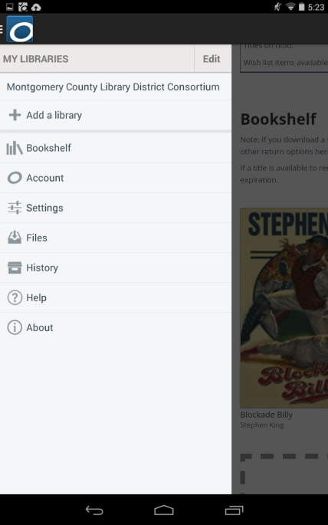
Finding and Borrowing a Library eBook
And tap on Bookshelf.

Slide 43
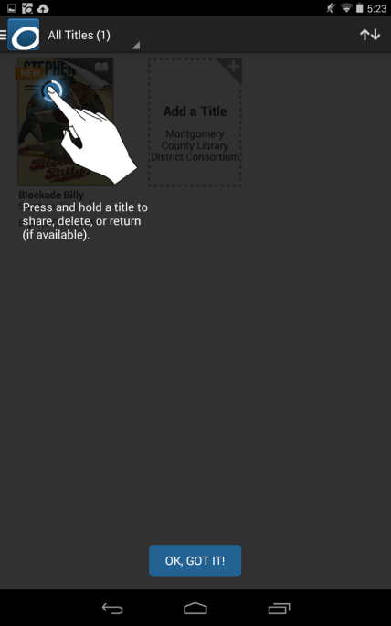
Finding and Borrowing a Library eBook
Another prompt may come up explaining how to manage books in your app’s bookshelf.
Tap the “OK, GOT IT!” button to continue.

Slide 44
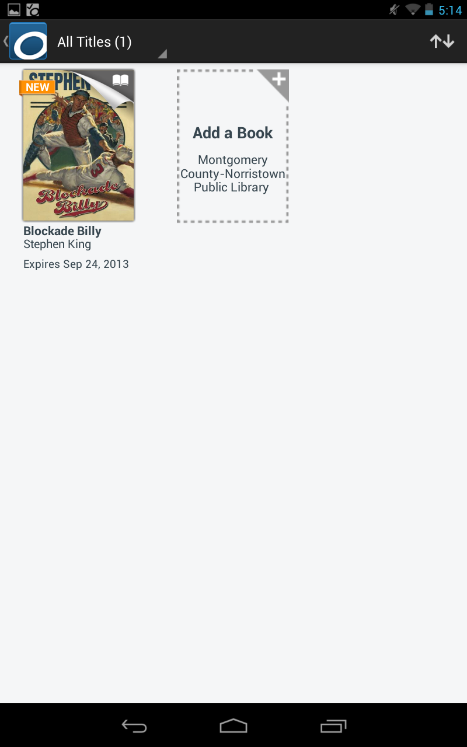
Finding and Borrowing a Library eBook
On your Bookshelf, you can tap on the book jacket to open it.

Slide 45
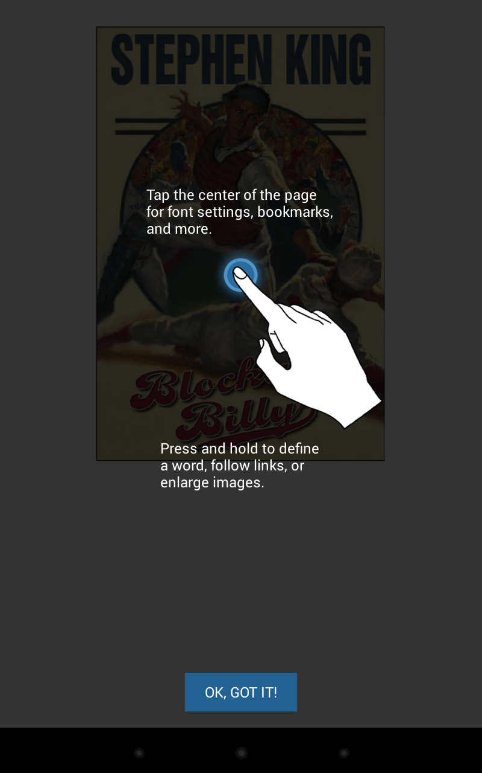
Finding and Borrowing a Library eBook
A prompt may come up explaining how to read books in the OverDrive app.
Tap the “OK, GOT IT!” button to continue.

Slide 46
Managing Your eBooks
This is the cover of the book. Swipe right or left to navigate through pages

Slide 47
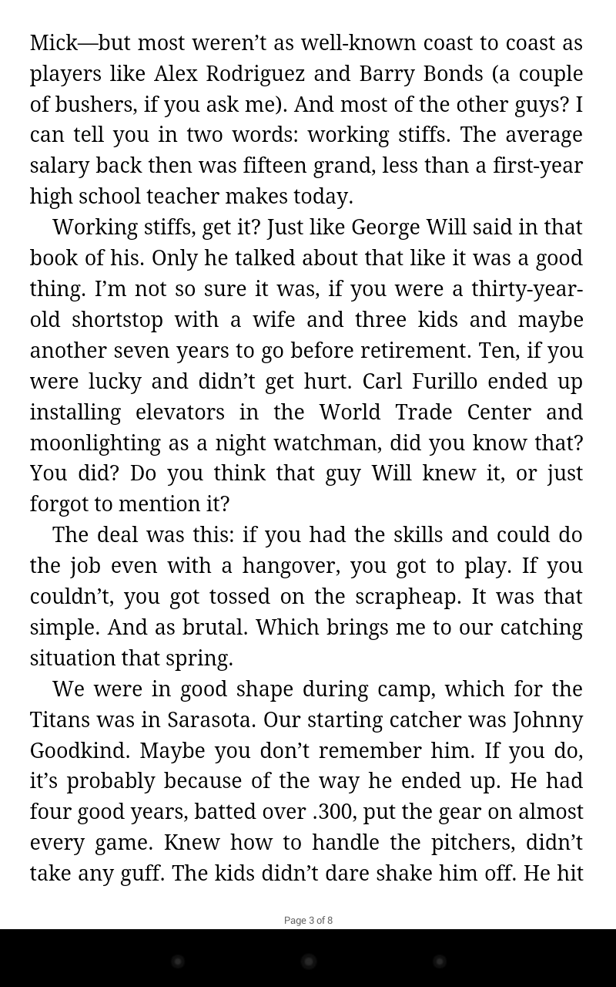
Managing Your eBooks
A page within the book – if you wanted to exit back to your bookshelf, just tap your device’s Back button.

Slide 48
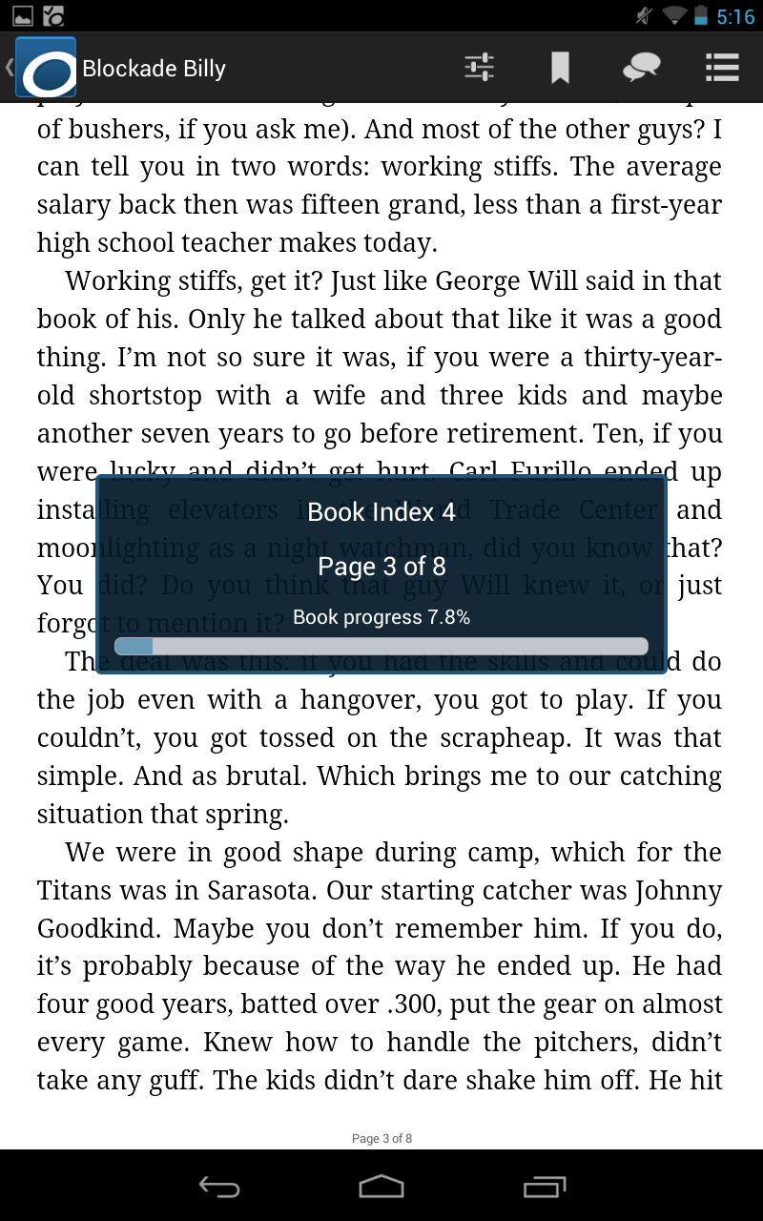
Managing Your eBooks
As you read your book there are certain controls available to you.
Let’s look at some of those.
You can check your reading progress by tapping on the center of a page in the book.
Now tap the Navigation button.

Slide 49
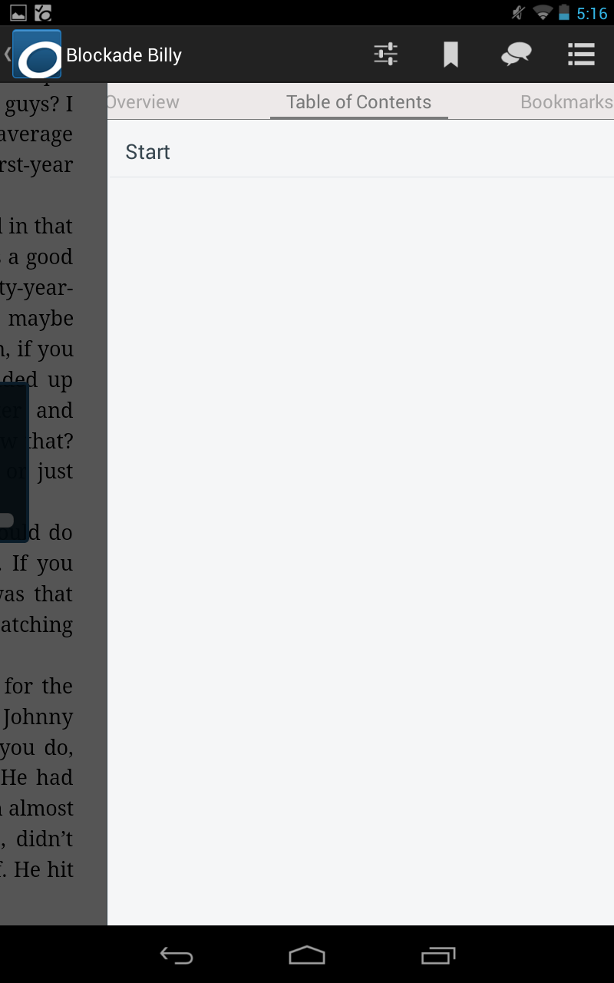
Managing Your eBooks
A display will show your chapter navigation. Note that not all books will be encoded with a table of contents, and you will still need to swipe to navigate through the pages.
Now tap the Settings button.

Slide 50
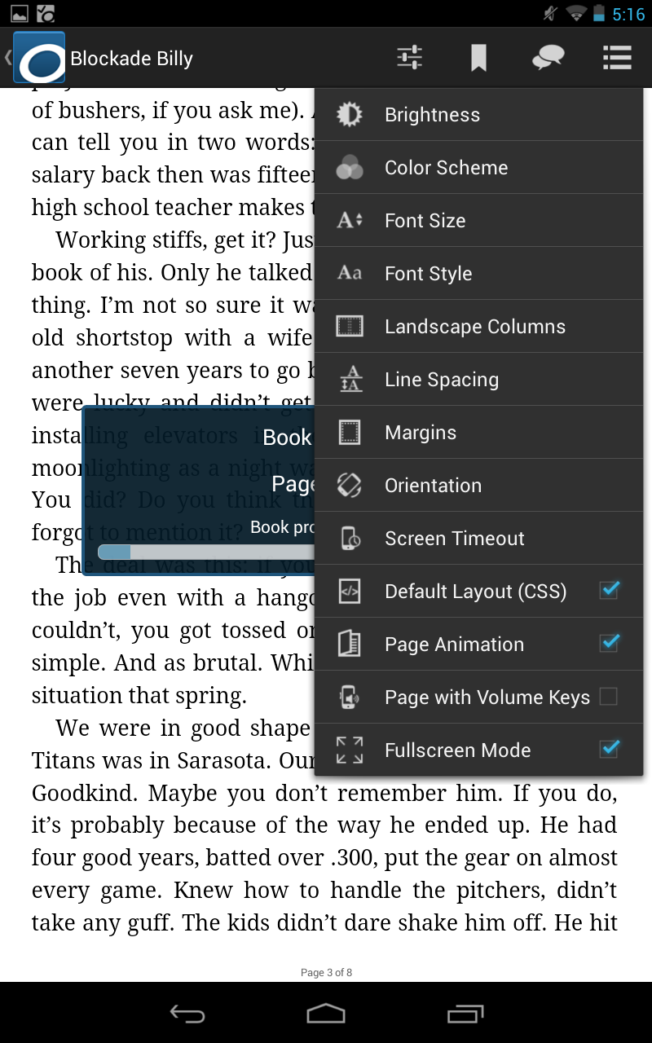
Managing Your eBooks
The settings menu is shown here with choices to improve or enhance your reading experience.
Now tap on the Bookmark button.

Slide 51
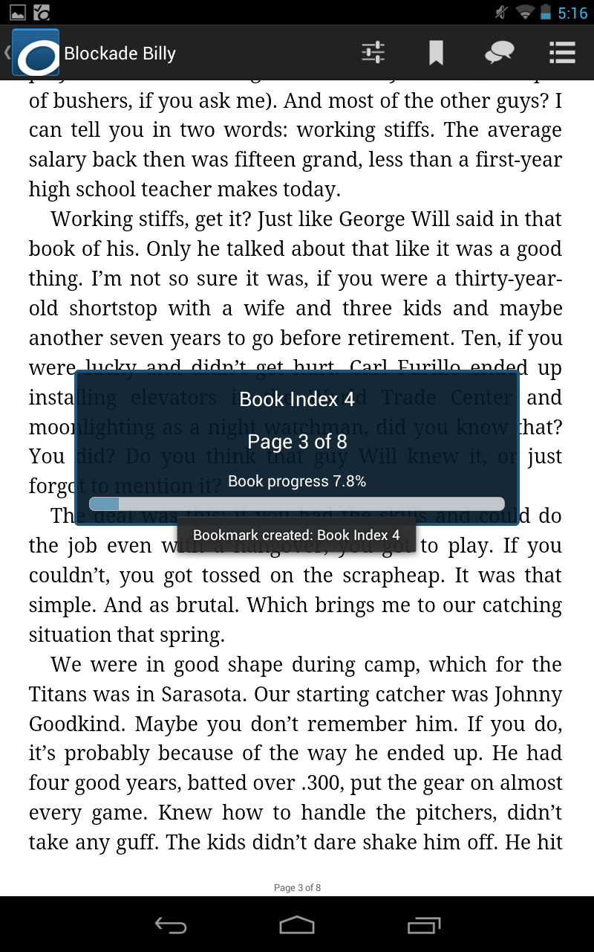
Managing Your eBooks
Bookmarking is not meant for saving your place in the book; that happens automatically when you stop reading. Bookmarking saves pages for you that you might want to read again.

Slide 52
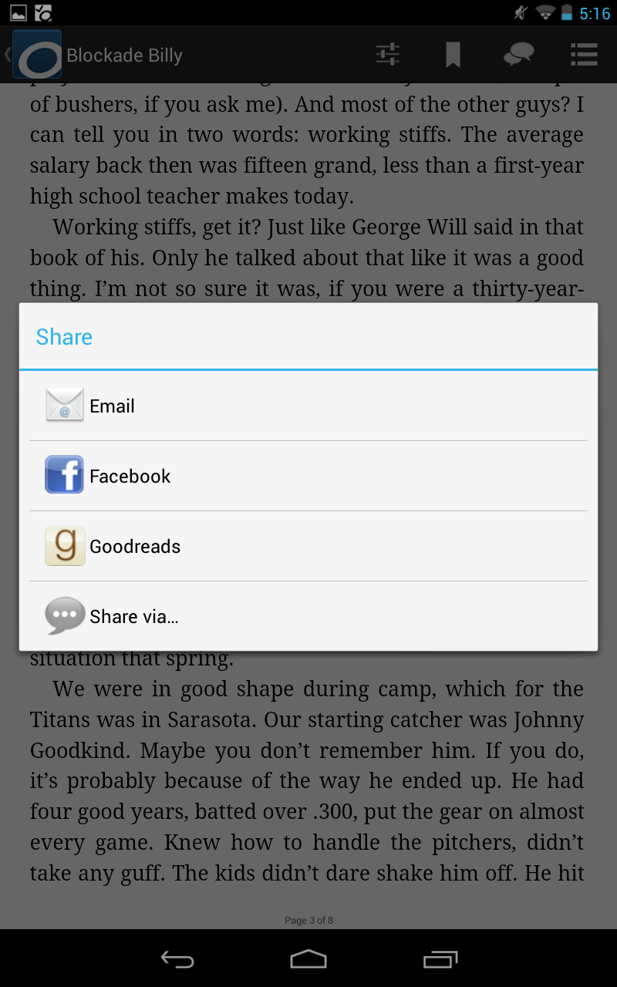
Managing Your eBooks
Tap the Share button.
The OverDrive app allows you to participate with your social media accounts directly to share what you are reading with others.

Slide 53
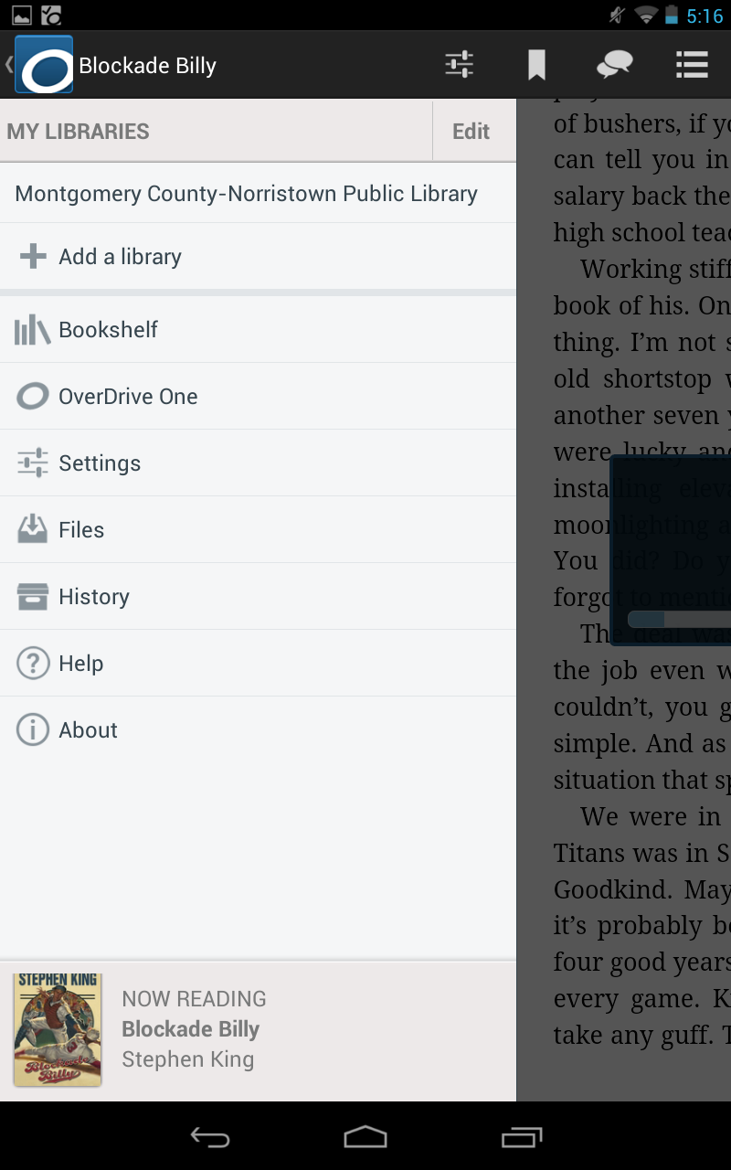
Managing Your eBooks
Tap the Menu button, then tap on Bookshelf from within the menu to return to the list of books on your device.

Slide 54
Managing Your eBooks
To return the book early, tap and hold on the book you want to return.

Slide 55
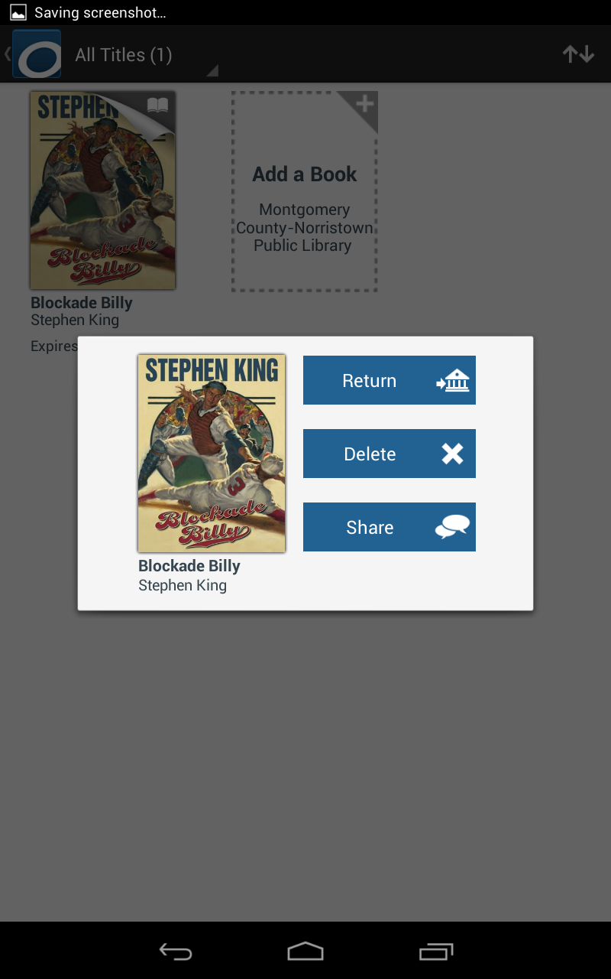
Managing Your eBooks
A prompt will pop up. Tap Return.

Slide 56
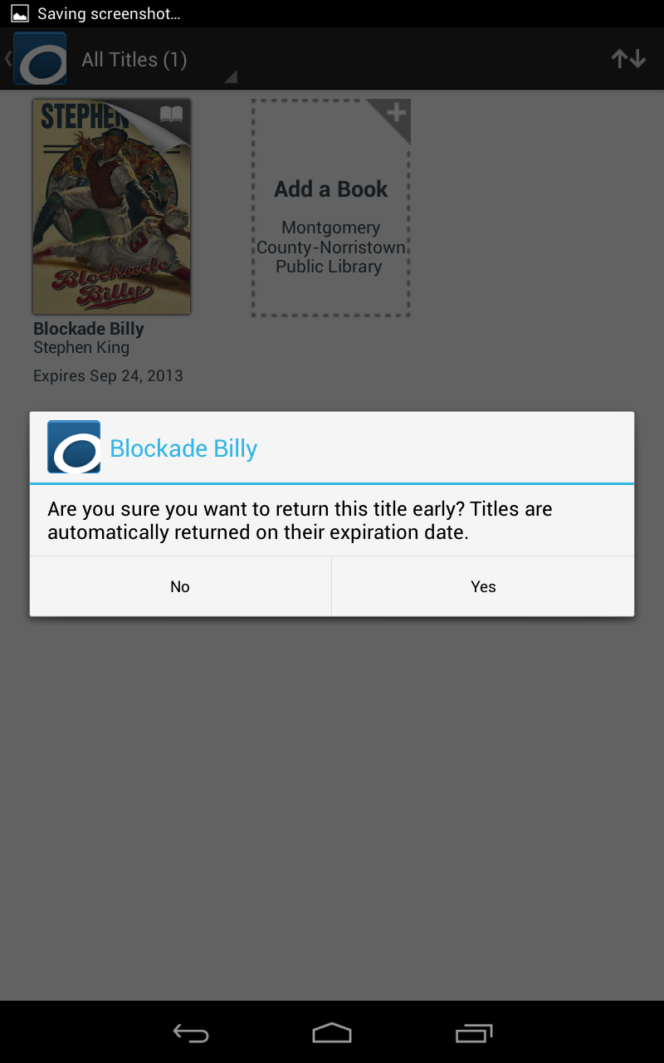
Managing Your eBooks
Tap Yes. This will return the book to the library, increasing books you can borrow on your account by one, and also deletes it from your device, freeing up space.

Slide 57
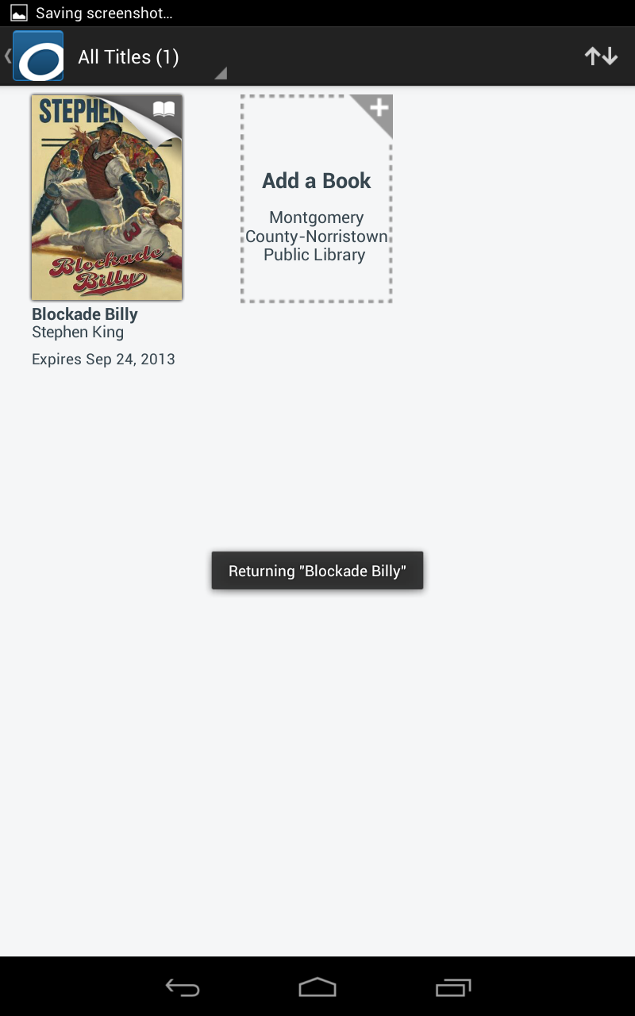
Managing Your eBooks
Note that Blockade Billy is being returned. Afterward, the book will automatically be deleted from your device.

Slide 58
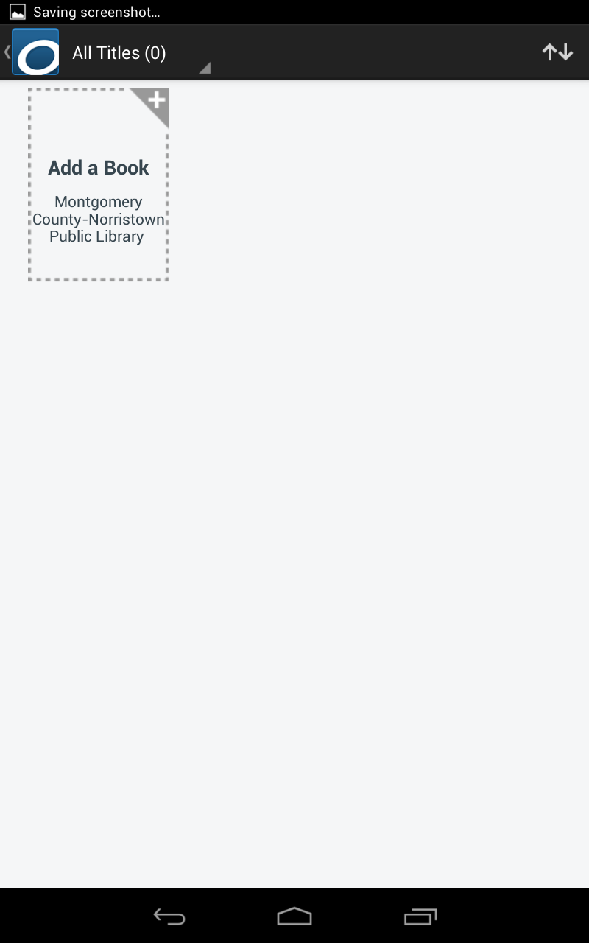
Managing Your eBooks
Our app bookshelf is now empty.
To borrow another book, just tap the “Add a Book” button and it will automatically open your library’s OverDrive website again so you can search for another book.

